Slide 1

SQL Project On Pizza Sales Analysis
Guided By : Ayushi Jain

Slide 2
Project Overview
Objective:
To analyze pizza sales data using SQL to identify key trends, optimize inventory management, and enhance sales strategies for improved business performance.
Dataset Overview: Four Tables
1) pizzas
2) order_details
3) pizza_types
4) orders

Slide 3
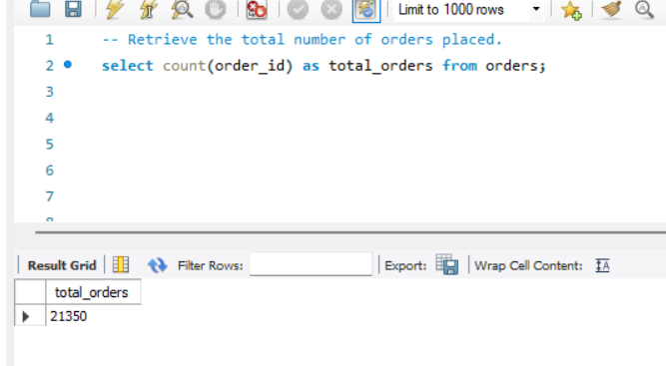
Q1. Retrieve the total number of orders placed?
select count(order_id) as total_orders from orders;

Slide 4
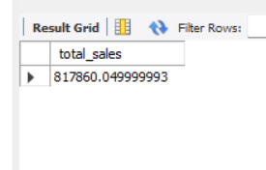
Q2. Calculate the total revenue generated from pizza sales?
select sum((pizzas.price *order_details.quantity)) as total_sales from pizzas join order_details on pizzas.pizza_id=order_details.pizza_id;

Slide 5
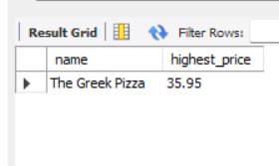
Q3. Identify the highest-priced pizza?
select pizza_types.name , pizzas.price as highest_price from pizza_types join pizzas on pizza_types.pizza_type_id =pizzas.pizza_type_id order by highest_price desc limit 1;

Slide 6
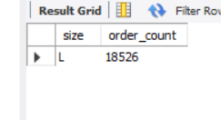
Q4. Identify the most common pizza size ordered?
select pizzas.size,count(order_details.order_details_id) as order_count from pizzas inner join order_details on pizzas.pizza_id = order_details.pizza_id group by pizzas.size order by order_count desc limit 1;

Slide 7
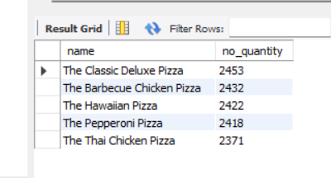
Q5. List the top 5 most ordered pizza types along with their quantities?
select pizza_types.name , sum(order_details.quantity) as no_quantity from pizzas inner join pizza_types on pizzas.pizza_type_id = pizza_types.pizza_type_id inner join order_details on pizzas.pizza_id=order_details.pizza_id group by pizza_types.name order by no_quantity desc limit 5;

Slide 8
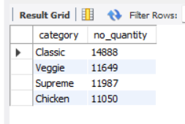
Q6. Join the necessary tables to find the total quantity of each pizza category ordered?
select pizza_types.category , sum(order_details.quantity) as no_quantity from pizzas inner join pizza_types on pizzas.pizza_type_id =pizza_types.pizza_type_id inner join order_details on pizzas.pizza_id=order_details.pizza_id group by pizza_types.category;

Slide 9
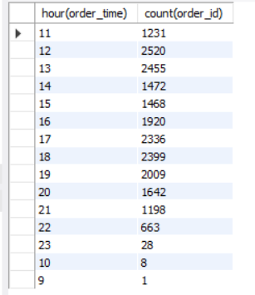
Q7. Determine the distribution of orders by hour of the day?
select hour(order_time), count(order_id) from orders group by hour(order_time);

Slide 10
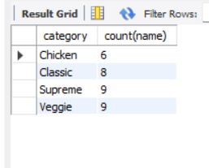
Q8. Join relevant tables to find the category-wise distribution of pizzas?
select category,count(name) from pizza_types group by category;

Slide 11
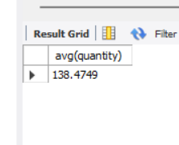
Q9. Group the orders by date and calculate the average number of pizzas ordered per day?
select avg(quantity) from (select orders.order_date , sum(order_details.quantity) as quantity from orders inner join order_details on orders.order_id = order_details.order_id group by orders.order_date) as order_quantity;

Slide 12
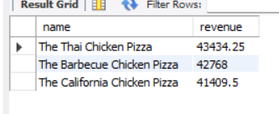
Q10. Determine the top 3 most ordered pizza types based on revenue?
select pizza_types.name , sum(pizzas.price*order_details.quantity) as revenue from pizzas inner join pizza_types on pizzas.pizza_type_id = pizza_types.pizza_type_id inner join order_details on pizzas.pizza_id = order_details.pizza_id group by pizza_types.name order by revenue desc limit 3;

Slide 13
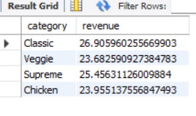
Q11. Calculate the percentage contribution of each pizza type to total revenue?
select pizza_types.category, (sum(pizzas.price*order_details.quantity)/(select sum((pizzas.price *order_details.quantity)) from pizzas join order_details on pizzas.pizza_id=order_details.pizza_id))*100 as revenue from pizzas inner join order_details on pizzas.pizza_id = order_details.pizza_id inner join pizza_types on pizzas.pizza_type_id = pizza_types.pizza_type_id group by pizza_types.category;

Slide 14
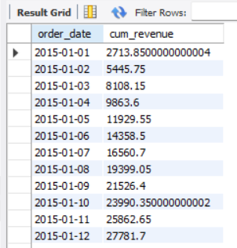
Q12. Analyze the cumulative revenue generated over time?
select order_date, sum(revenue) over(order by order_date) as cum_revenue from (select orders.order_date,sum(pizzas.price*order_details.quantity) as revenue from pizzas inner join order_details on pizzas.pizza_id = order_details.pizza_id inner join orders on order_details.order_id = orders.order_id group by orders.order_date) as sales;

Slide 15
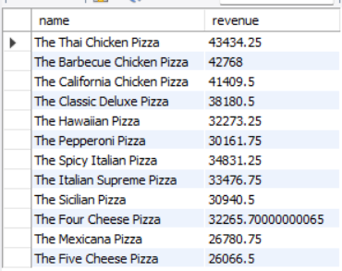
Q13. Determine the top 3 most ordered pizza types based on revenue for each pizza category?
select name,revenue from (select category, name, revenue, rank () over (partition by category order by revenue desc) as rnk from (select pizza_types.category,pizza_types.name,sum(pizzas.price*order_details.quantity) as revenue from pizzas inner join order_details on pizzas.pizza_id = order_details.pizza_id inner join pizza_types on pizzas.pizza_type_id = pizza_types.pizza_type_id group by pizza_types.category,pizza_types.name) as a) as b where rnk<=3;

Slide 16
Thank You

